Slide 1

Modern Control Theory
Lecture No. 8
Controllability & Observability -- an Overview with E.g.
Sampling, Z-domain, Mapping of S-plane to Z-plane
Concept of Stability

Slide 2
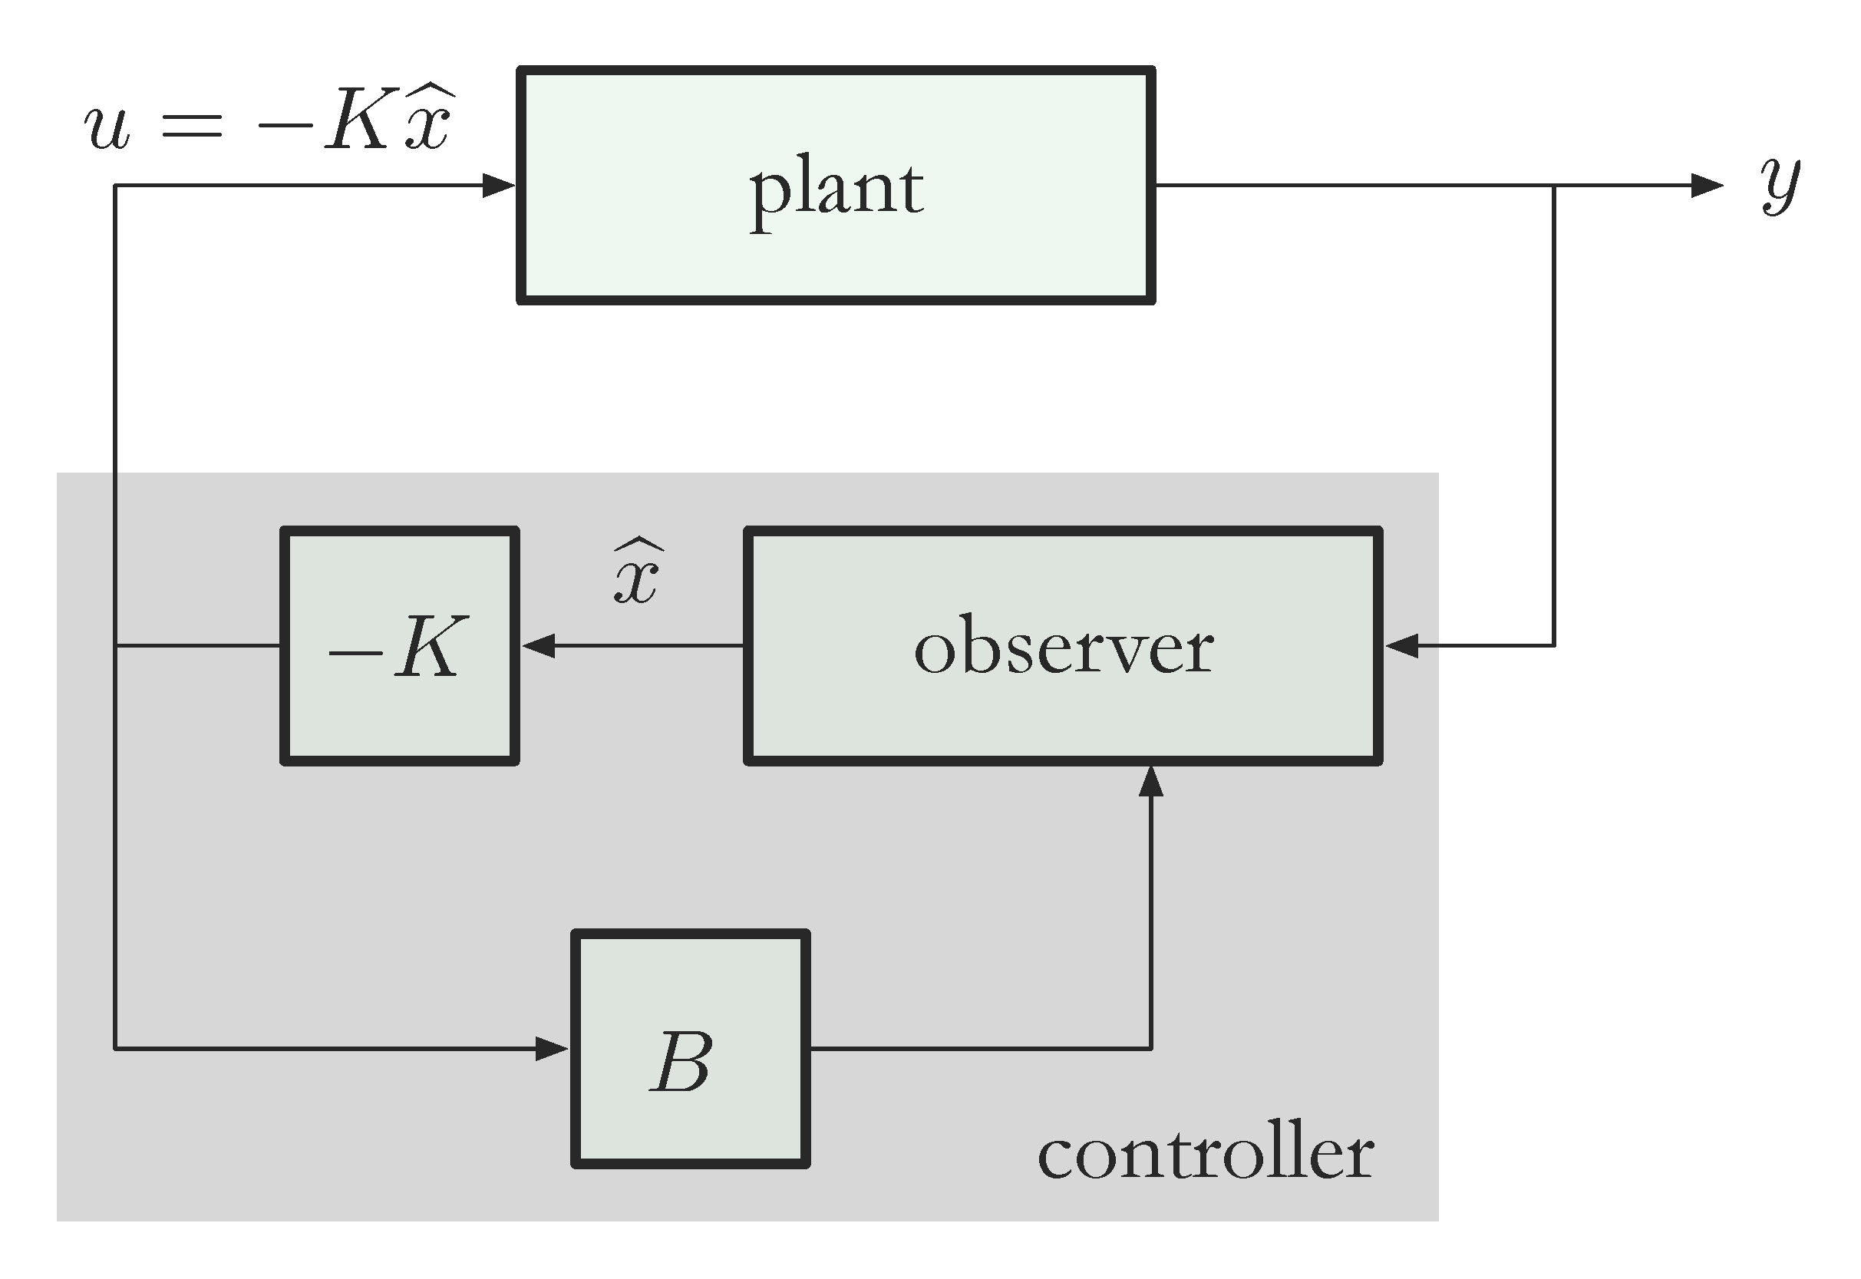



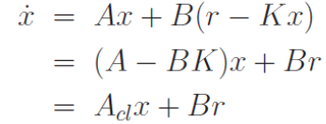
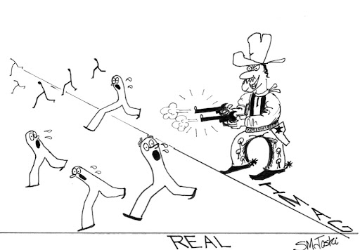
Controllability & Observability --- An Overview
State Space
X(k)
Observation Space /
Measurement Space
Input Space
X(0)

Slide 3


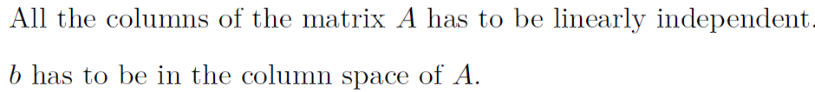
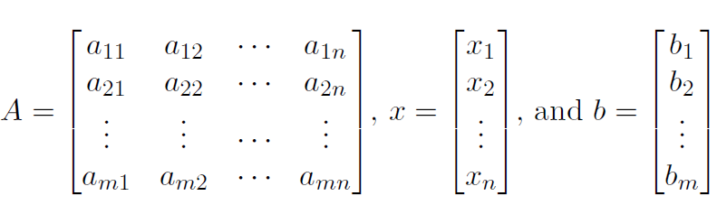
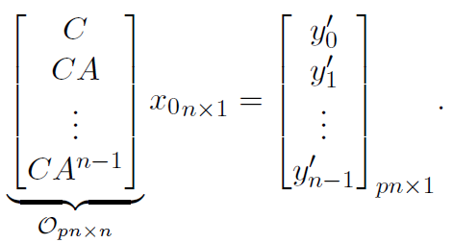


Controllability
Observability
Cols. of A --- Span the Complete Space of R
Matrix A has m l.i. Columns
All Rows of A are l.i. since No. of l.i Cols. = No. of l.i. Rows
Condn. on A to have at least one soln. for every vector b E R, is that A should be of full row rank
Cols.
All Vectors in A should be l.i. Full Rank, Square

Slide 4
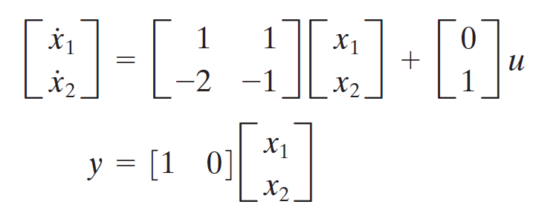
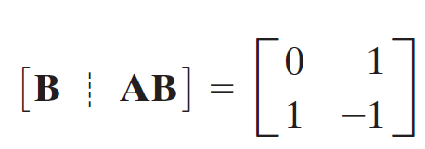
Check for Controllability & Observability

Slide 5

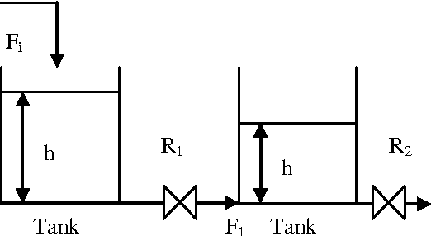


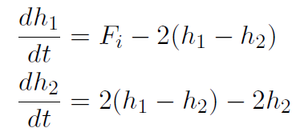
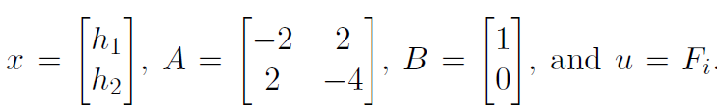
Check for Controllability

Slide 6
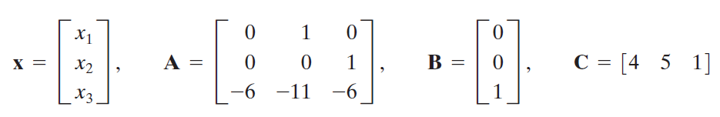
Check for Controllability & Observability

Slide 7
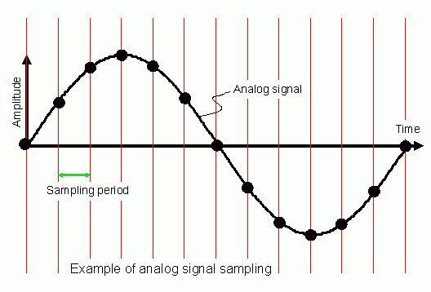

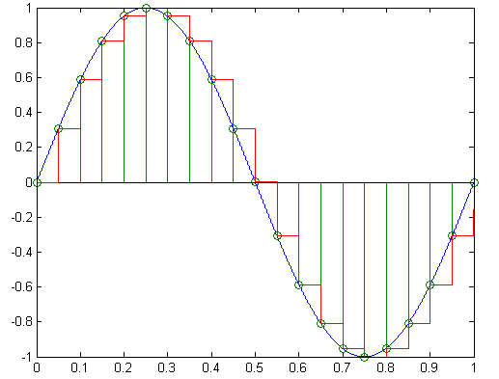
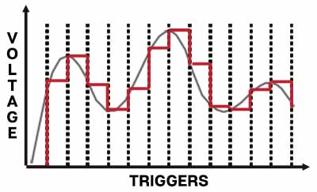
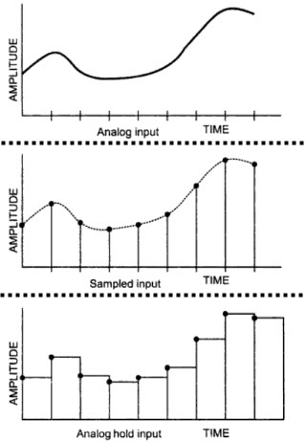
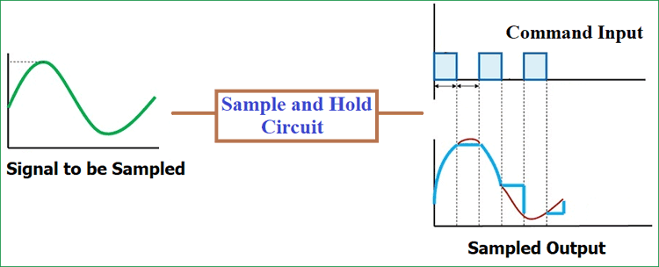
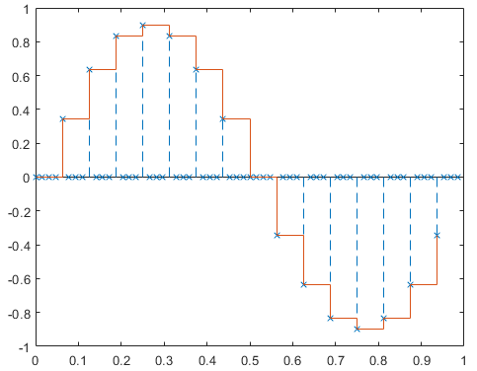
Sampling
Hold at Sampling Instants

Slide 8
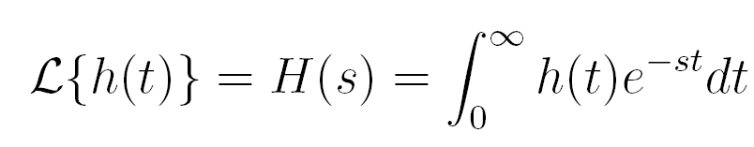
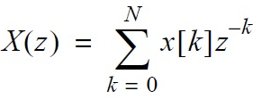
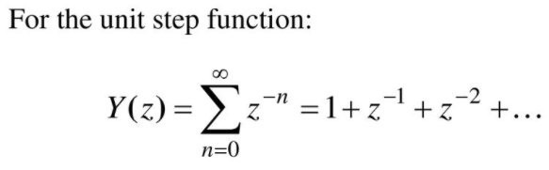
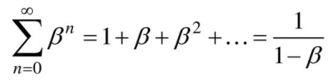
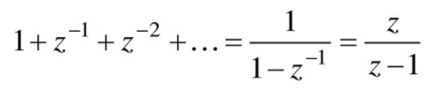
Concept of Z-Transforms
Understanding Z-transforms
Bilinear Transforms
Transient Characteristics
Root Locus
Bode Plots

